Slide 1

Resource-Efficient
Multi-Modal Ensemble
for Automated Content
Compliance Validation
Samsung R&D Institute,
Bengaluru
Devansh Singh

Slide 2
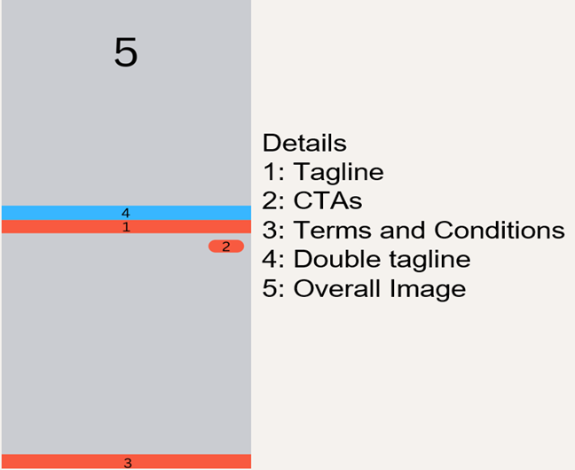
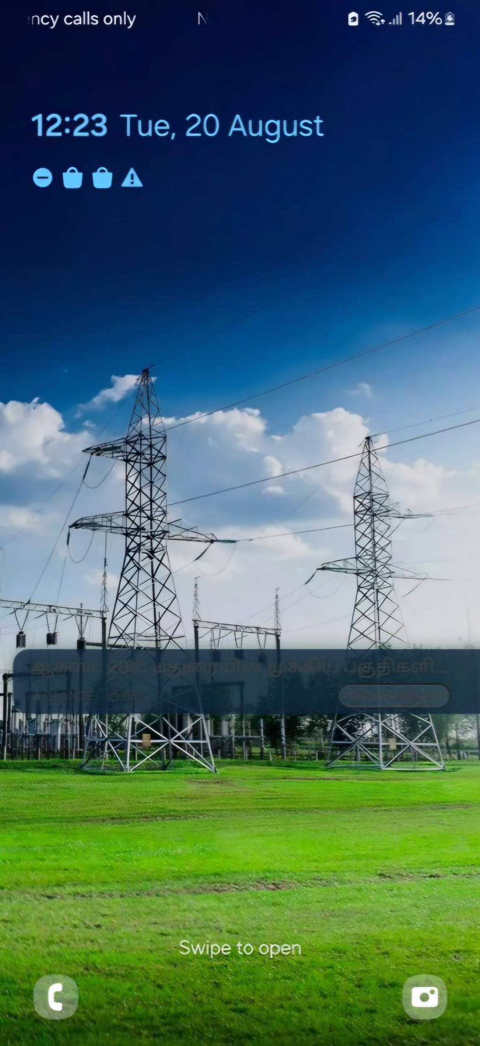
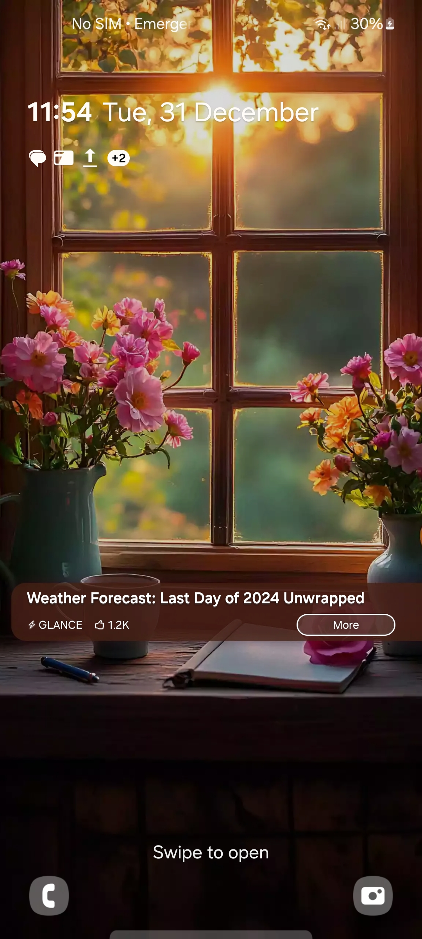
THE CHALLENGE
❌ Non-Compliant
✅ Compliant
CONTEXT
Samsung lock screens display third-party content (from Glance) to millions of devices. Each story must pass 20+ compliance criteria before deployment.
40+ hrs/week manual validation — subjective & unscalable
RESEARCH QUESTION
⚠ CORE FINDING: Typical VLMs on all criteria simultaneously → ≈30% accuracy. Excelled at text but failed on semantic tasks.
Can a task-decomposed ensemble of small, specialized models match the accuracy of large-scale models under a strict <3 GB VRAM constraint?
Tagline unreadable
(non-English script)
Clear tagline, CTA,
readable content

Slide 3
RESEARCH METHODS — Task-Decomposed Ensemble Architecture
METHODOLOGY: Assign each compliance task to the model architecturally best suited for it.
🖼 Lock Screen Image
EasyOCR
~0.3 GB
InternVL 2.5-1B
~1.8 GB
CLIP (OpenAI)
~0.5 GB
Perceptual Proxy
Precise OCR + VQA
Semantic Classification
Readable tagline?
Blank image?
Has tagline?
CTAs / price tags
T&Cs / hyperlinks
Ribbon & logo overlap
Offensive / Religious
Political / Gambling
Theme appropriateness
Total Pipeline: ~2.6 GB VRAM ✓

Slide 4
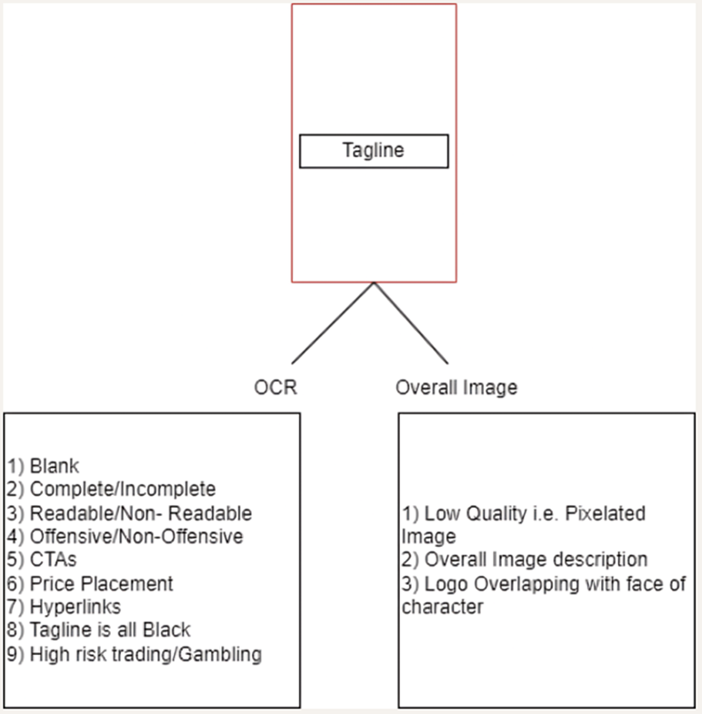
RESEARCH METHODS — Model Selection Rationale
Compliance Criteria Tree
👁 EasyOCR
Intentionally less accurate — exploited as a human readability proxy. If EasyOCR cannot read the tagline, a lock screen user likely cannot either.
Perceptual Proxy | ~0.3 GB
🔎 InternVL 2.5-1B
Highest OCR accuracy across colorful backgrounds. Handles visual grounding via VQA — ribbon detection, logo overlap, CTA and price/T&C extraction.
Precise OCR + VQA | ~1.8 GB
🧠 CLIP (OpenAI)
Zero-shot contrastive classification. Image and text labels mapped to a shared embedding space; cosine similarity determines classification.
Semantic Classification | ~0.5 GB

Slide 5
RESEARCH METHODS — Open-Vocabulary Semantic Classification
CHALLENGE: Compliance criteria evolve constantly. Re-engineering VLM prompts for each new rule is expensive and error-prone.
SOLUTION: Structured contrastive label arrays — CLIP computes cosine similarity between image embedding and each label, then assigns the highest match.
EXAMPLE — Safety Classification:
Label
A
"Digital art or sports or news or miscellaneous... nature or scenery or lifestyle or travel or food..."
Default / Safe
Label
B
"Hindu Deity / OM or AUM or Swastik symbol"
Restricted: Religious
Label
C
“Gore, blood, smoking, alcohol, drugs, gambling,… "
Restricted: Inappropriate
OPERATIONAL ADVANTAGE
Zero model retraining for new rules · Non-ML engineers update by editing text strings · New category = append one string

Slide 6
KEY FINDINGS & SIGNIFICANCE
Pipeline Comparison
Configuration | Accuracy | VRAM | Latency
Single VLM Baseline (MiniCPM only) | ≈30% | ~8 GB | 12 sec
Heavy Ensemble (MiniCPM + SigLip + Stepfun) | 98.3% | ~14 GB | 18 sec
Our Ensemble ★ (InternVL + CLIP + EasyOCR) | 97.6% | ~2.6 GB | 4 sec
1
5.4× Memory Reduction
2
Task Decomposition is Necessary
Only 0.7% accuracy trade-off vs the 14 GB heavy pipeline, with 4× latency speedup.
Single-model baseline failure at 30% confirms decomposition is essential, not optional.
3
Imprecision as Design Signal
4
Zero-Shot Classification
EasyOCR's weakness exploited as a human perceptual proxy for readability assessment.
Structured CLIP label arrays achieve sufficient semantic accuracy with zero training data.

Slide 7
BROADER IMPACT ON MACHINE LEARNING
01 ⚙
02 🔍
03 📋
Task-Decomposed Ensembles
Model Imprecision as Feature
Open-Vocabulary Classification
as a Design Pattern
Proxy for Human Perception
for Evolving Taxonomies
When compute is constrained and tasks span multiple modalities, decomposing across specialized small models can outperform a single generalist model.
A model's weakness on a task can serve as a proxy for human perceptual limits — transferable to accessibility research and UI/UX evaluation.
Zero-shot contrastive models with structured label arrays enable ML systems that adapt to changing requirements without retraining.
→ Content moderation · Medical imaging triage · AV perception
→ Accessibility testing · Automated UI review · UX evaluation
→ Evolving content policy · Regulatory compliance · Moderation
DEPLOYMENT IMPACT · Pipeline in UAT at Samsung R&D · 40+ hrs/week of manual review eliminated · Validated on production data (6-month independent UAT)

Slide 8
RESEARCH INTERESTS & GOALS AT MBZUAI
RESEARCH INTERESTS
MSc RESEARCH GOALS
🖼 Multi-Modal Learning & VLMs
1
Principled Task Routing
Extending my work on task-aware model composition — moving from empirical selection to learned task routing.
Investigate learned methods for decomposing multi-modal tasks across model ensembles — moving beyond empirical model assignment.
⚡ Resource-Efficient AI
2
Knowledge Distillation
Quantization, knowledge distillation, and edge deployment for real-world constrained environments.
Explore compressing ensemble behavior into single efficient models while preserving task-specific accuracy gains.
🔬 LLM Truthfulness & Hallucination
3
Hallucination Detection w/ Prof. Nakov
Grounding LLMs in reality — using internal model signals to detect fabrication and verify factual claims.
Collaborate with Prof. Preslav Nakov to explore how internal model signals can mathematically ground LLMs — preventing fabrication in continuously evolving systems.
WHY MBZUAI · World-class compute infrastructure · AI as scientific discipline & societal good · Prof. Nakov’s work on LLM hallucination directly aligns with my research goals

